Slide 1
Introduction to AI

Slide 2
Introduction to AI engineering
Topics~ 1. AI ENGINEERING OVERVIEW 2. Enterprise AI Architecture

Slide 3
AI engineering overview
AI Engineering Overview
AI Engineering is a field that focuses on designing, developing, and deploying artificial intelligence systems to solve real-world problems. It combines concepts from artificial intelligence, machine learning, data science, and software engineering to create intelligent applications. AI engineers develop systems that can analyze data, learn from patterns, and make decisions with minimal human intervention. AI Engineering is widely used in areas such as healthcare, finance, education, transportation, and customer service to improve efficiency and productivity.

Slide 4
Enterprise AI architecture
Enterprise AI Architecture
Enterprise AI Architecture refers to the structured framework that enables organizations to integrate artificial intelligence into their business operations. It combines data sources, AI models, software applications, and computing infrastructure to create intelligent systems that support business goals. A well-designed AI architecture ensures that AI solutions are scalable, secure, and efficient. It also helps organizations manage data effectively, automate processes, and improve decision-making across different departments.

Slide 5
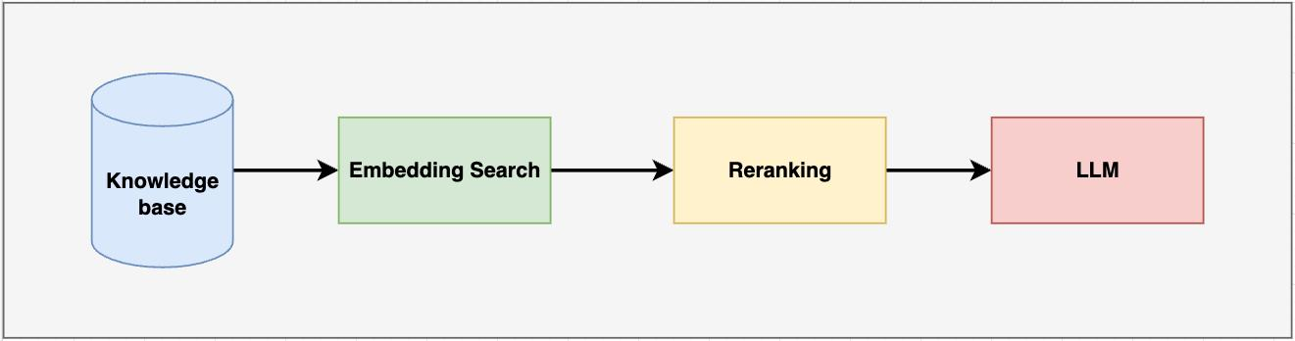

Slide 6
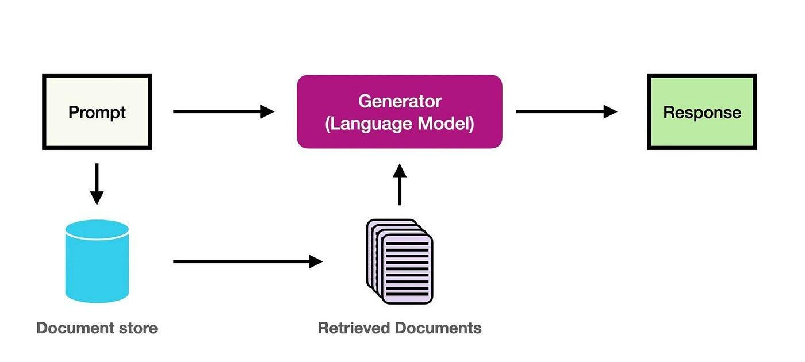

Slide 7
Information Retrieval Fundamentals
Topics~ 1. Documents 2. Queries 3. Ranking system

Slide 8
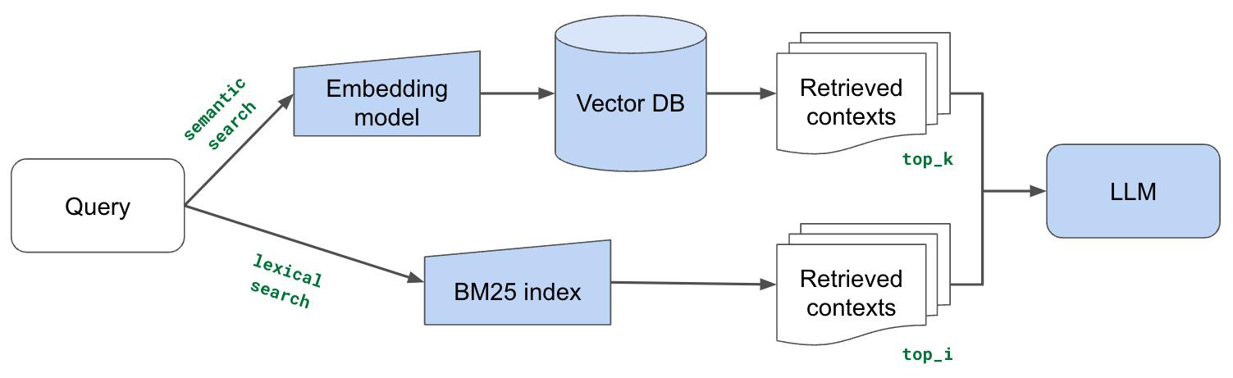
LLM

Slide 9
Documents
In Information Retrieval, documents are the stored units of information that a system can search through to provide answers to a user’s request. These documents can include web pages, books, articles, reports, emails, images, or any other form of digital content.
Documents form the main data collection in an information retrieval system. When a user enters a query, the system scans through these documents to find the ones that best match the request.
The quality, structure, and organization of documents directly affect how accurately and efficiently relevant information can be retrieved.

Slide 10
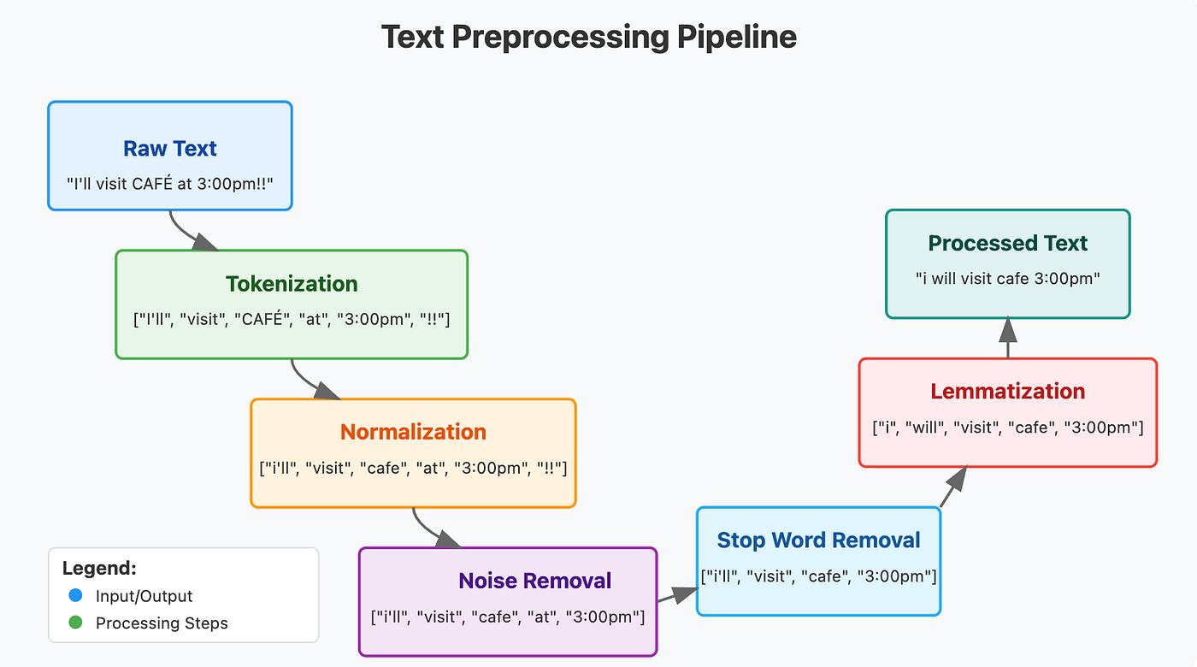

Slide 11
Queries
In Information Retrieval, a query is the input given by a user to search for specific information from a collection of documents. It represents what the user is looking for and acts as the starting point of the search process.
A query can be a word, a phrase, or a full question depending on the user’s need. When a query is submitted, the system analyzes it and compares it with stored documents to find the most relevant results.
Queries are important because the accuracy of search results depends on how clearly the user expresses their information need. A well-formed query helps the system return better and more relevant documents.

Slide 12
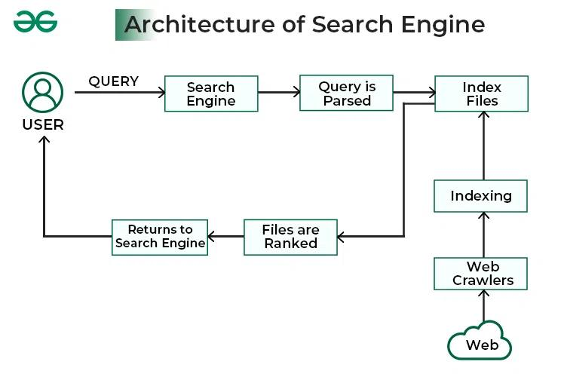

Slide 13
Ranking system
In Information Retrieval, a ranking system is used to arrange search results in order of relevance to a user’s query. After the system retrieves a set of matching documents, it evaluates and ranks them so that the most useful and relevant information appears first.
The ranking is based on different factors such as keyword matching, frequency of terms, document quality, and sometimes user behavior data. The goal is to ensure that users can quickly find the most accurate and helpful results without having to manually search through all documents.
A good ranking system improves the efficiency of search engines and enhances user experience by saving time and providing better-quality results at the top.

Slide 14
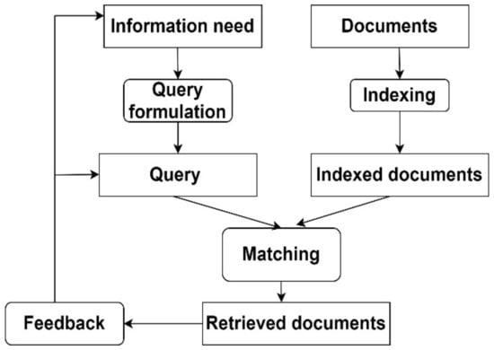

Slide 15
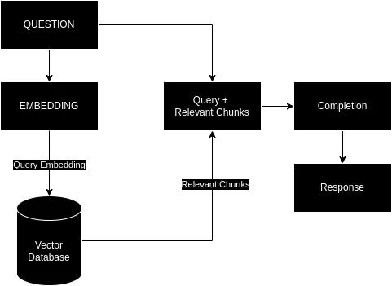

Slide 16
NLP & Text Processing
Topics~ 1. Tokenization 2. Lemmatization 3. Stop-word Removal

Slide 17
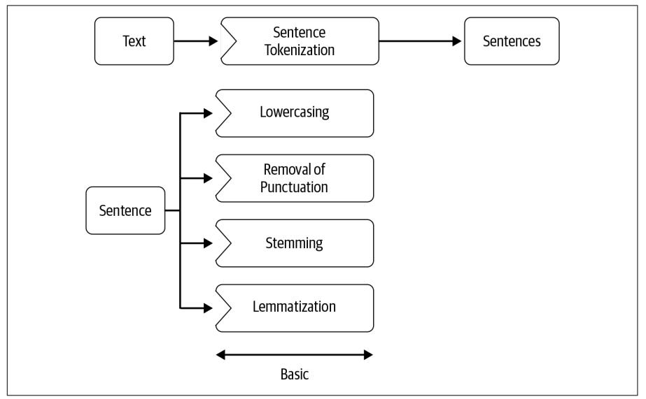

Slide 18
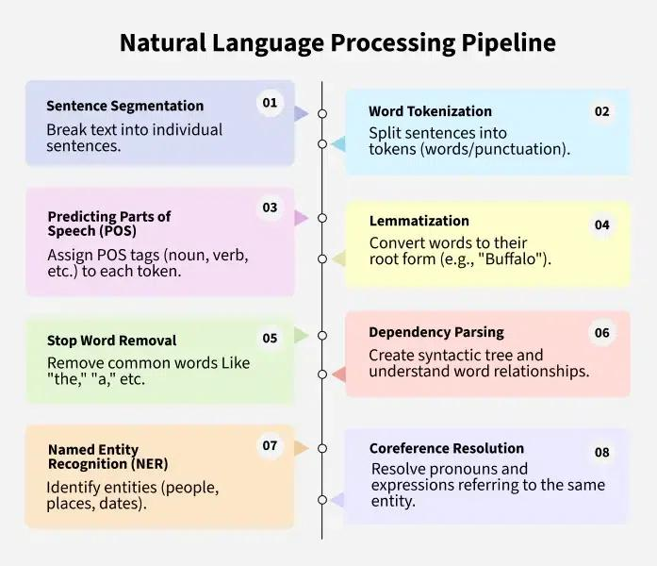

Slide 19
Tokenization
Tokenization is the process of breaking down a text into smaller units called tokens. These tokens can be words, phrases, or sentences depending on the requirement of the system.
For example, the sentence “AI is fun” can be split into tokens: “AI”, “is”, “fun”. This helps the system understand and process text more effectively.
Tokenization is the first step in many natural language processing tasks because it converts raw text into manageable pieces for analysis.

Slide 20
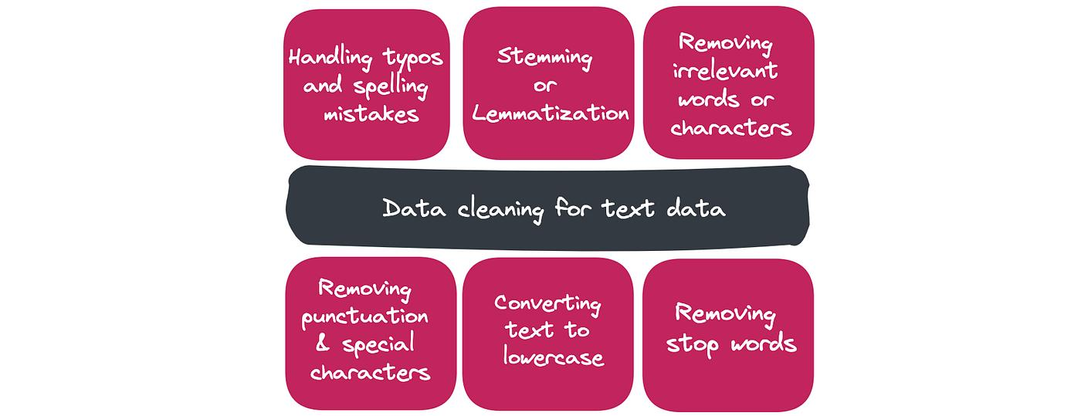

Slide 21
Lemmatization
Lemmatization is the process of converting words into their base or dictionary form, known as the lemma. It considers the meaning of the word and the context in which it is used.
For example, words like “running”, “ran”, and “runs” are converted to “run”.
This helps the system treat different forms of a word as a single meaningful unit, improving accuracy in text analysis and search results.

Slide 22
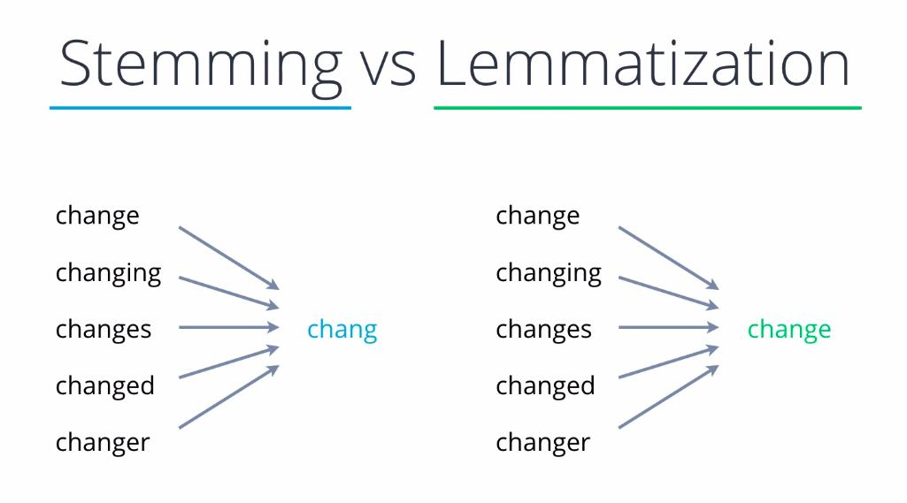

Slide 23
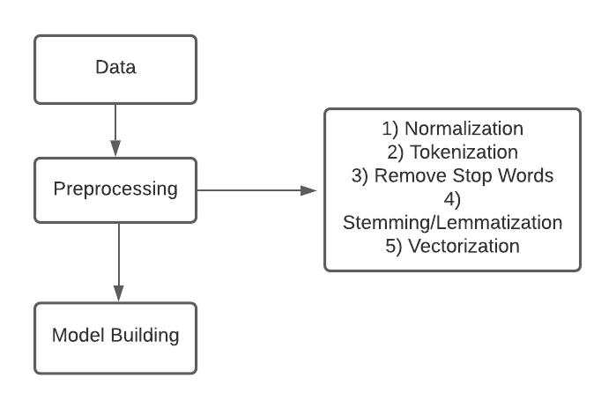

Slide 24
Stop-word removal
Stop-word removal is the process of removing common words from text that do not carry significant meaning. These words include “is”, “the”, “and”, “a”, and “in”.
For example, in the sentence “The AI is very powerful”, the words “the” and “is” can be removed.
This step helps reduce noise in data and allows the system to focus on important words that carry actual meaning.

Slide 25
TF-IDF & BM25 Ranking
Topics~ 1. Lexical Search 2. Query Optimization

Slide 26
Lexical search
Lexical search is a method of searching documents based on exact word matching between the user’s query and the content of documents.
It does not understand meaning or context but focuses on matching keywords directly. If the same words appear in both the query and the document, the document is considered relevant.
This method is fast and commonly used in traditional search systems, but it may miss results where different words are used to express the same meaning.

Slide 27
Query optimization
Query Optimization
Query optimization is the process of improving a user’s search query to get better and more relevant results from a system.
It involves techniques like correcting spelling mistakes, expanding queries with similar words, or rephrasing the input to match better with available documents.
The goal of query optimization is to increase the accuracy and efficiency of search results while reducing irrelevant outputs.

Slide 28
Elasticsearch & Azure AI Search
Topics~ 1. Indexing 2. Query DSL 3. Hybrid Search

Slide 29
Indexing
Indexing is the process of organizing and storing data in a structured format so that it can be searched efficiently. In search systems, documents are analyzed and key terms are stored in an index.
This index acts like a reference system, allowing the search engine to quickly locate relevant documents without scanning the entire dataset.
Indexing improves search speed and makes retrieval of information more efficient, especially in large datasets.

Slide 30
Query DSL
Query DSL (Domain Specific Language) is a structured way of writing queries in search systems like Elasticsearch. It allows users to define precise search conditions using a flexible and powerful syntax.
With Query DSL, users can filter results, match specific fields, rank relevance, and combine multiple conditions in a single query.
It provides more control and accuracy compared to simple keyword searching, making it useful for advanced search applications.

Slide 31
Hybrid search
Hybrid search is a method that combines traditional keyword-based search with modern semantic search techniques. It uses both exact matching (lexical search) and meaning-based understanding to improve search results.
This approach helps retrieve documents that match keywords as well as those that are contextually relevant, even if they use different words.
Hybrid search improves accuracy, relevance, and user experience by balancing precision and meaning-based understanding.

Slide 32
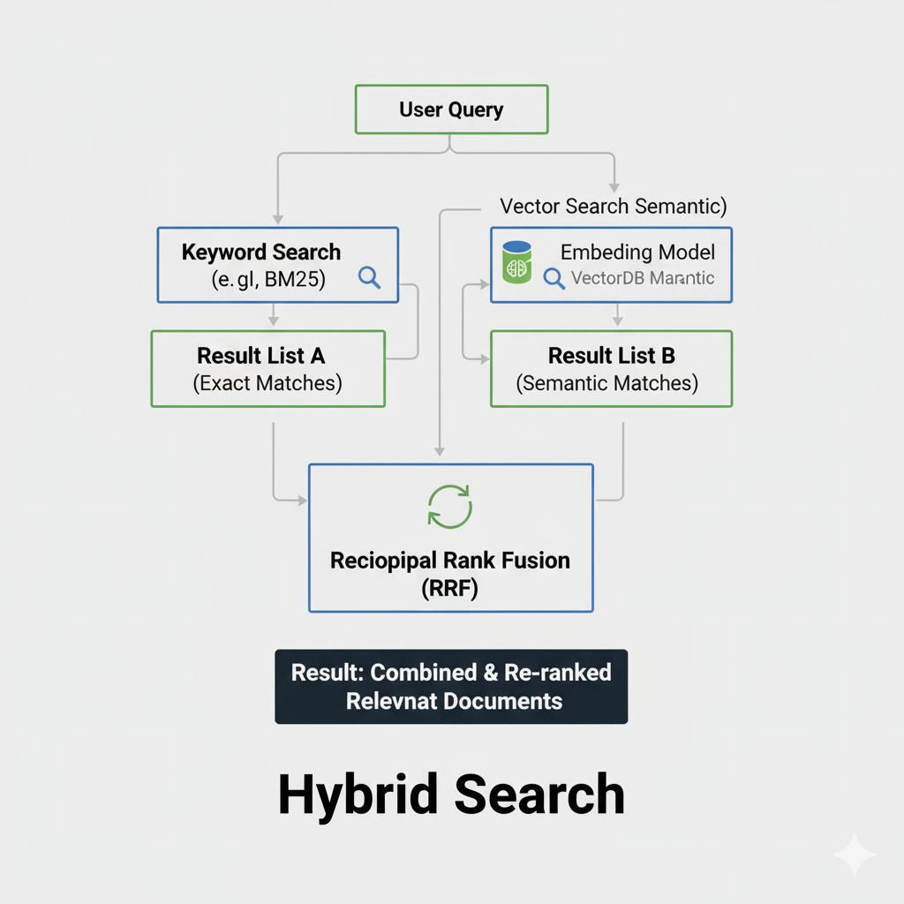

Slide 33
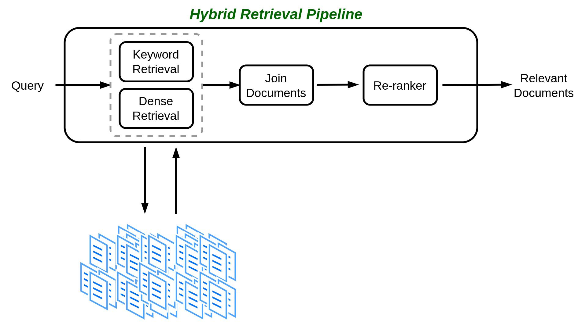

Slide 34
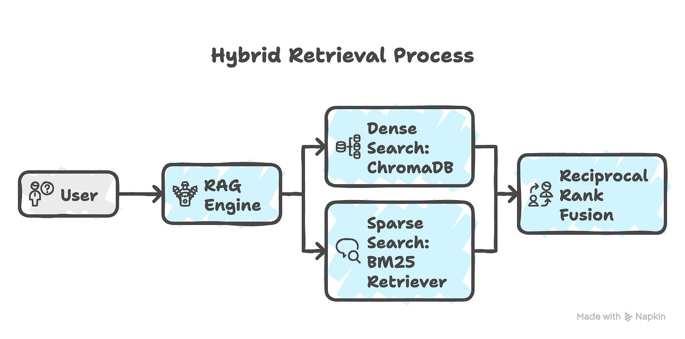

Slide 35
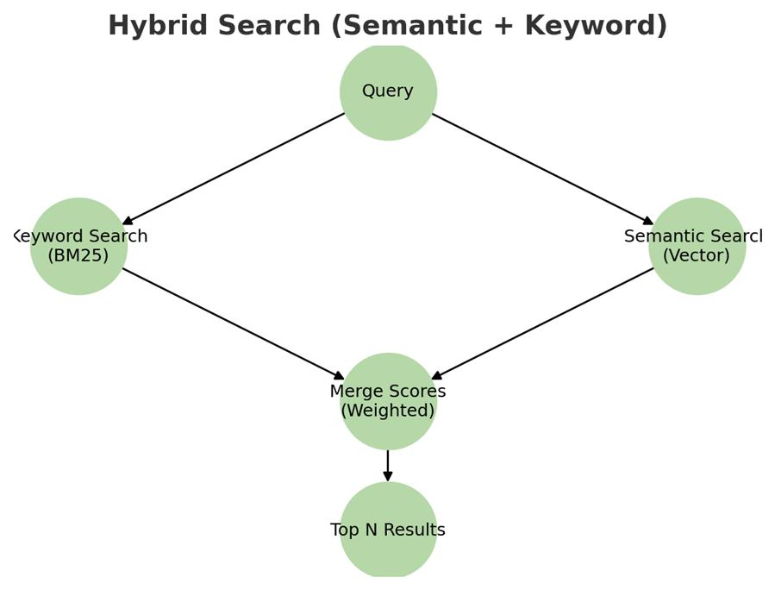

Slide 36
Embeddings & Semantic Search
Topic~ 1. Vector Embeddings 2. Similarity Search

Slide 37
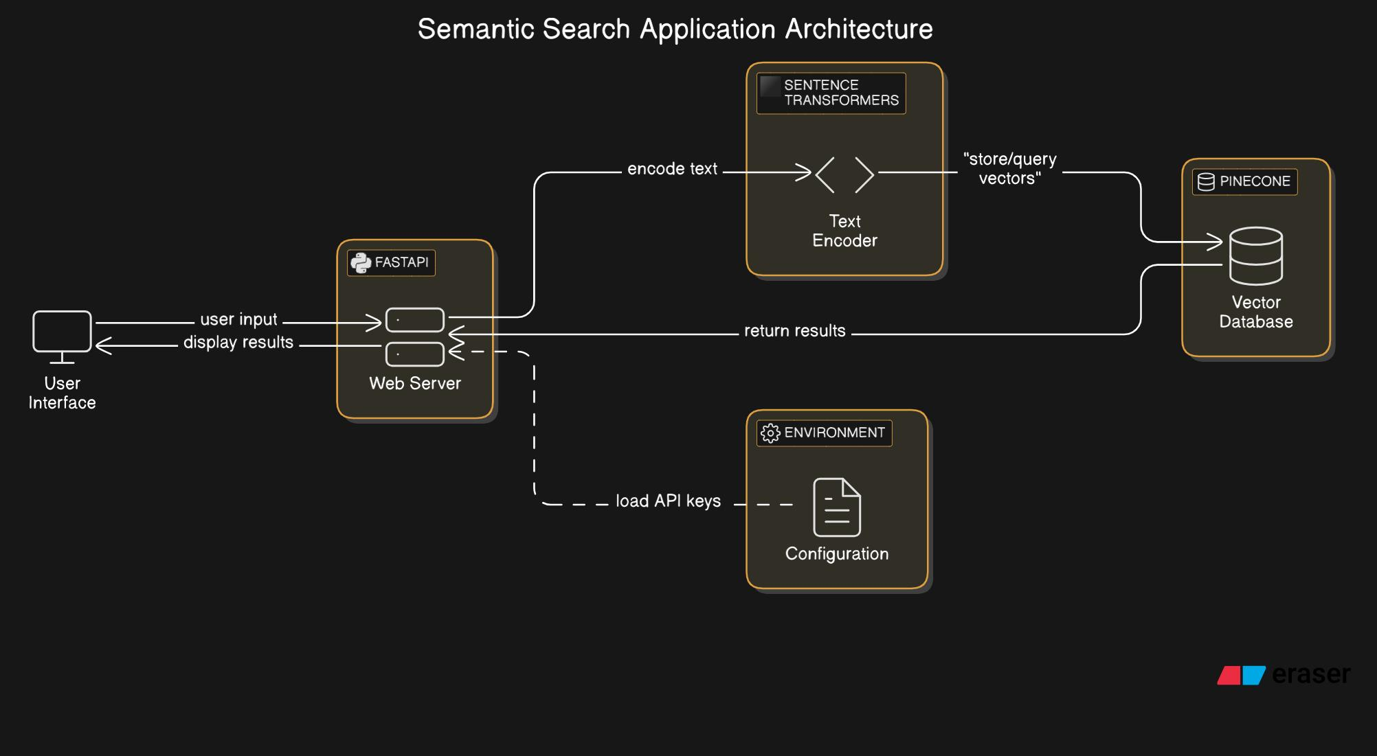

Slide 38
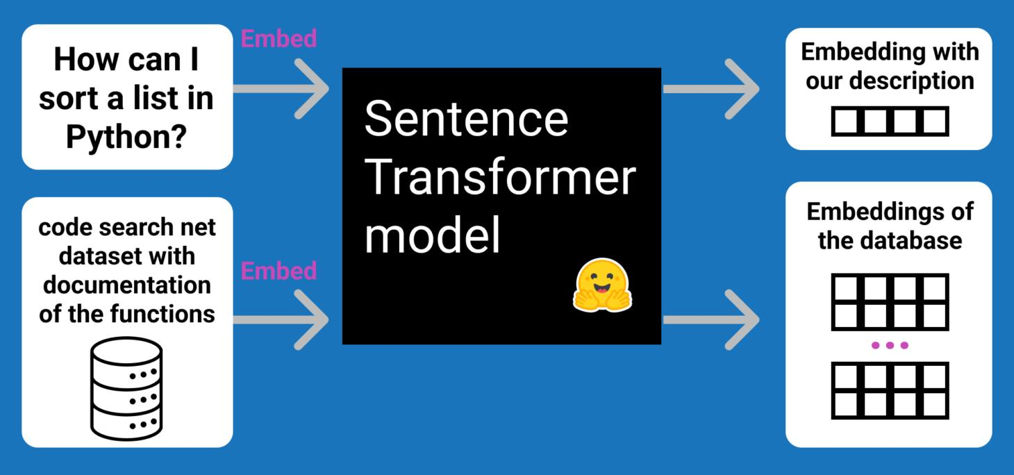
Sentence Transformer Model

Slide 39
Vector embeddings
Vector embeddings are numerical representations of words, sentences, or documents in a multi-dimensional space. These vectors capture the meaning and context of the text so that similar ideas are placed closer together.
For example, words like “car” and “automobile” will have similar vector representations even if they are different in spelling.
Embeddings allow machines to understand semantic relationships between words and improve search accuracy.

Slide 40
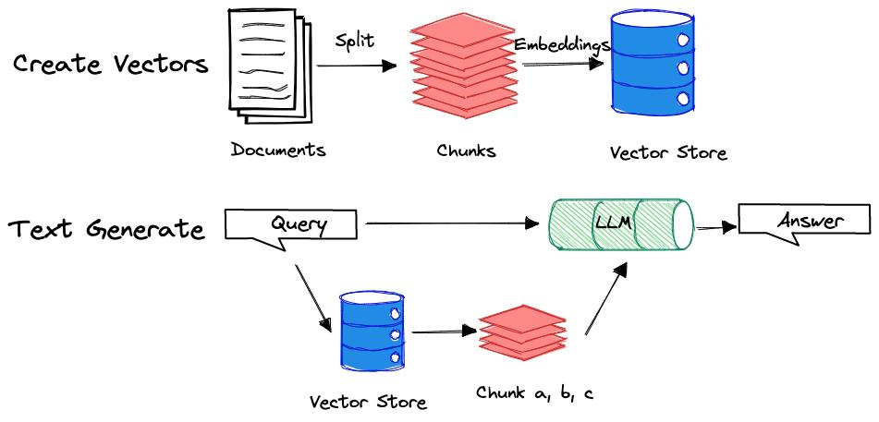
Flow diagram

Slide 41
Similarity search
Similarity search is the process of finding items that are closest in meaning to a given query using vector embeddings.
Instead of matching exact words, it compares the distance between vectors in a high-dimensional space. The closer the vectors, the more similar the meaning.
This method helps retrieve relevant results even when different words or phrases are used, improving the quality of search in modern AI systems.

Slide 42
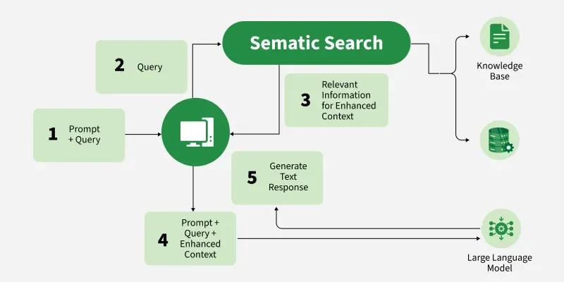
Semantic Search

Slide 43
Vector Databases
1. ANN Search 2. HNSW 3. Pinecone 4. Qdrant

Slide 44
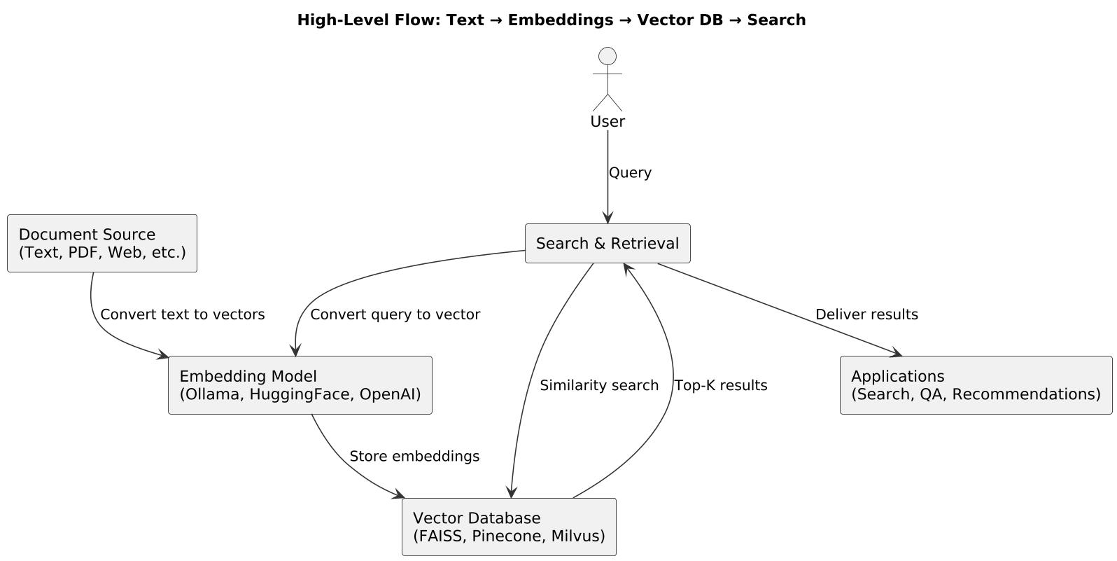

Slide 45
ANN search (Approximate Nearest Neighbour)
ANN Search is a technique used to quickly find data points that are closest to a given query vector in a large dataset.
Instead of searching every possible item (which is slow), ANN finds approximate nearest matches, making the search much faster while maintaining high accuracy.
It is widely used in vector databases to enable real-time search at scale.

Slide 46
HNSW (Hierarchical Navigable Small World)
HNSW is an advanced algorithm used for Approximate Nearest Neighbour search in vector databases. It organizes data into a multi-layer graph structure, allowing efficient navigation through connections to find similar vectors quickly. HNSW is popular because it provides a strong balance between speed and accuracy in large-scale similarity search systems.

Slide 47
Pinecone
Pinecone is a fully managed vector database service designed for building and scaling AI-powered applications. It allows developers to store, index, and search vector embeddings without needing to manage infrastructure or complex backend systems.
It is commonly used in applications such as semantic search, recommendation systems, and retrieval-augmented generation (RAG), where fast and accurate similarity search is required.
Pinecone handles large-scale data efficiently by automatically managing indexing, updates, and query performance. This makes it a popular choice for production-level AI systems where speed, reliability, and scalability are important.

Slide 48
Qdrant
Qdrant is an open-source vector database built for storing, managing, and searching high-dimensional vector embeddings efficiently. It is designed to support AI applications that rely on semantic understanding and similarity search.
One of its key features is advanced filtering, which allows users to combine vector similarity search with structured metadata filters. This makes it possible to perform more precise and context-aware searches.
Qdrant is widely used in machine learning and generative AI systems, especially in use cases like recommendation engines, semantic search, and retrieval-augmented generation (RAG), where both speed and accuracy are essential.

Slide 49
Chunking & Hybrid Retrieval
Topics~ 1. Semantic Chunking 2. BM25 + Vector Search

Slide 50
Semantic chunking
Semantic chunking is the process of dividing large text into smaller sections based on meaning rather than fixed size. Each chunk represents a complete idea or meaningful context.
This approach helps maintain context while splitting documents, so that important information is not broken in unnatural places. It improves the quality of search and retrieval in AI systems because each chunk is meaningful on its own.
Semantic chunking is commonly used in systems like chatbots and retrieval-augmented generation (RAG) to ensure better understanding of long documents.

Slide 51
BM25 + vector search (hybrid retrieval)
BM25 + Vector Search is a hybrid retrieval approach that combines traditional keyword-based search (BM25) with modern semantic search using vector embeddings.
BM25 focuses on exact keyword matching and ranking based on term frequency, while vector search focuses on meaning and context similarity. By combining both methods, the system can retrieve results that are both precise and semantically relevant.
This hybrid approach improves search accuracy by ensuring that important keyword matches are not missed, while also capturing results that may use different wording but have similar meaning.

Slide 52
RAG Architecture
Topics~ 1. Prompt Engineering 2. Context Augmentation

Slide 53
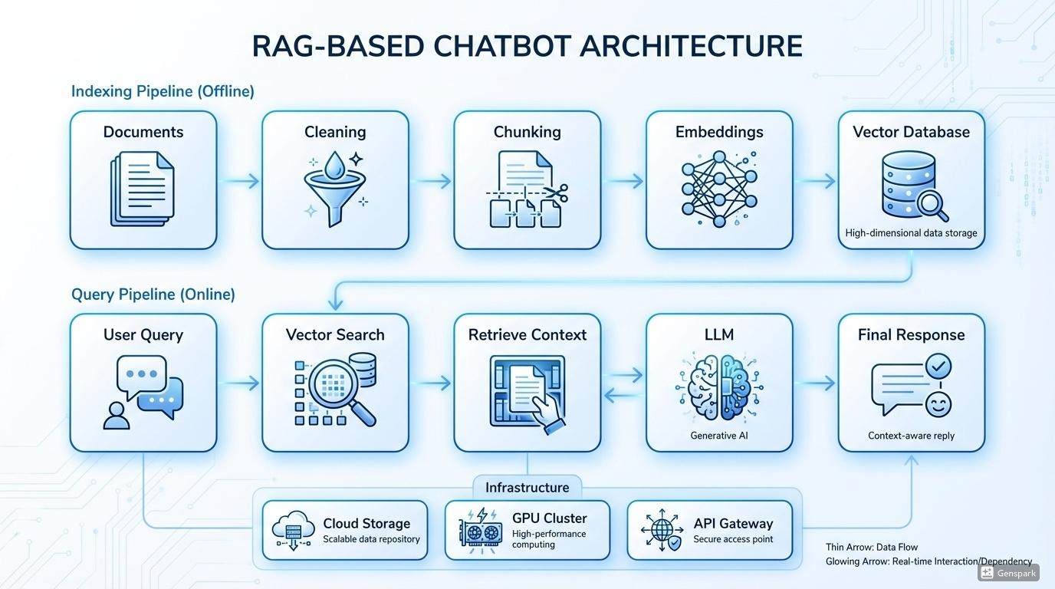

Slide 54
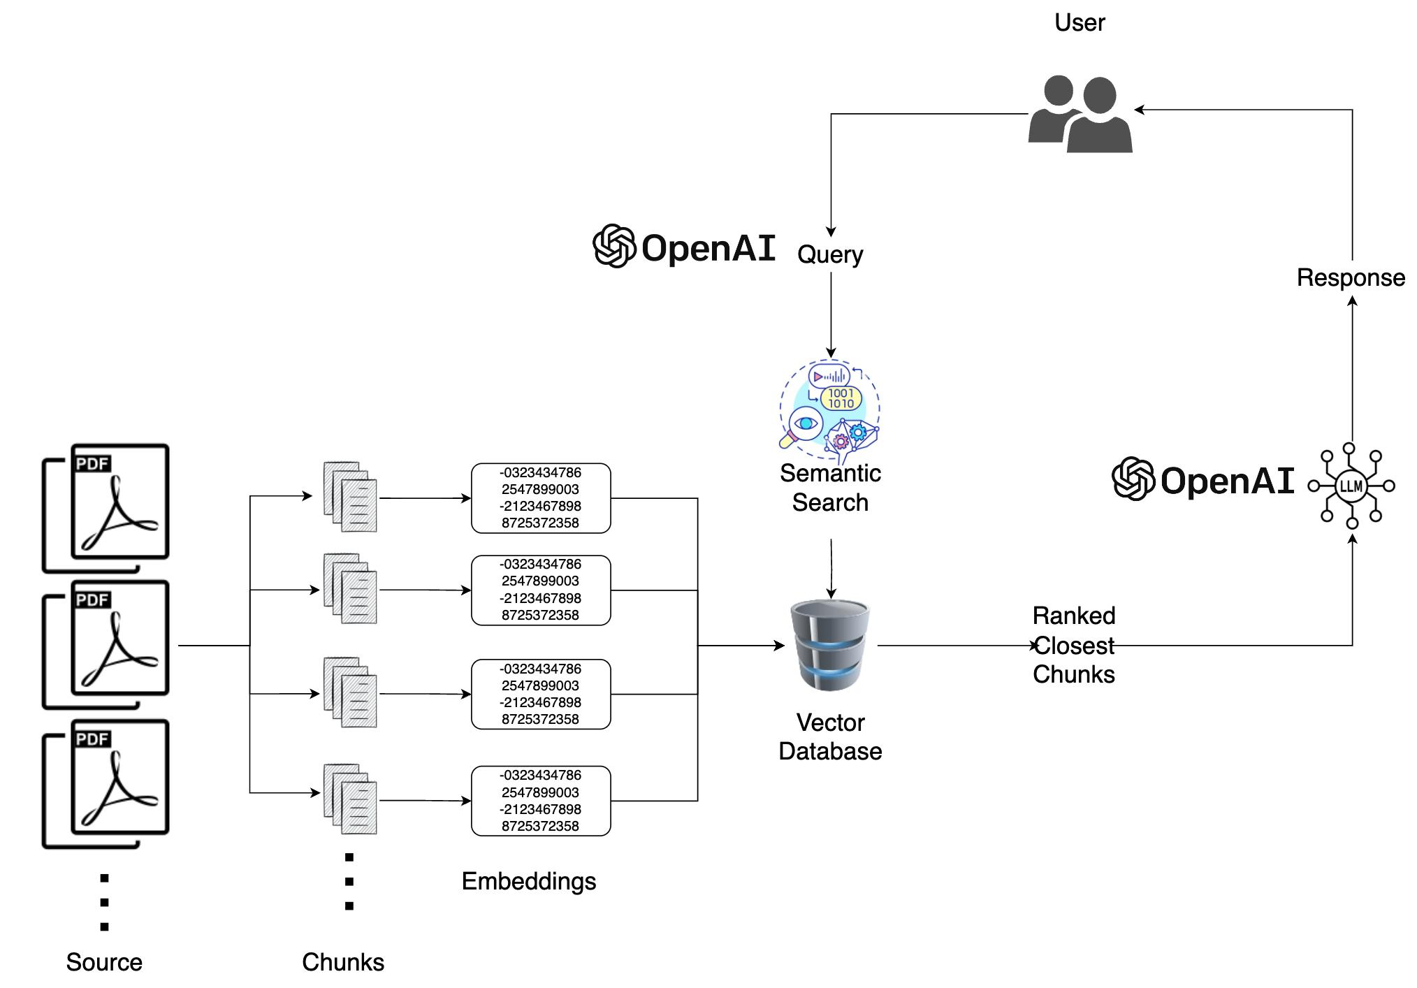

Slide 55
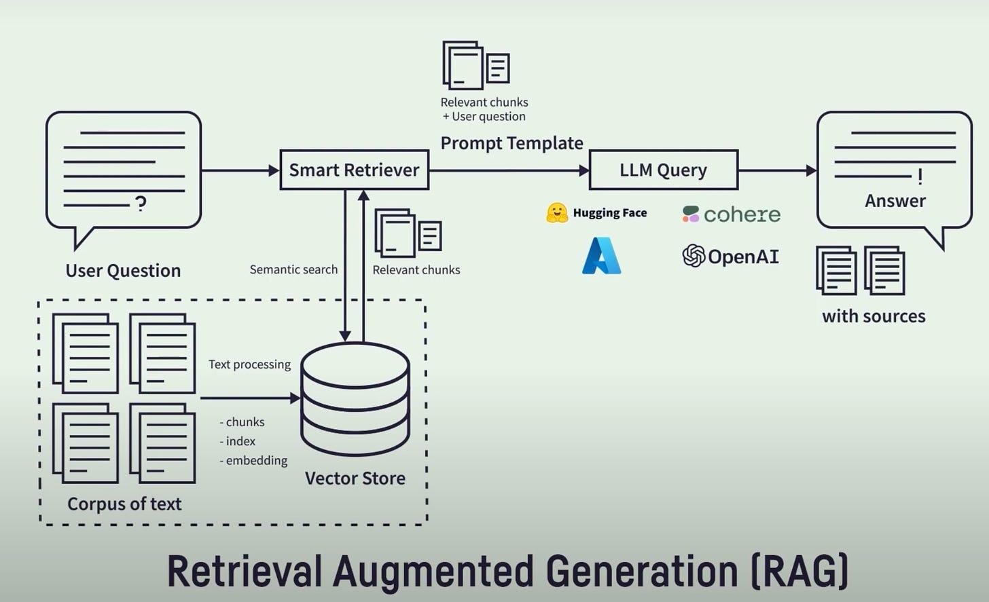

Slide 56
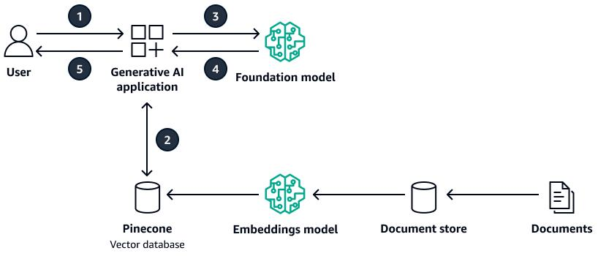

Slide 57
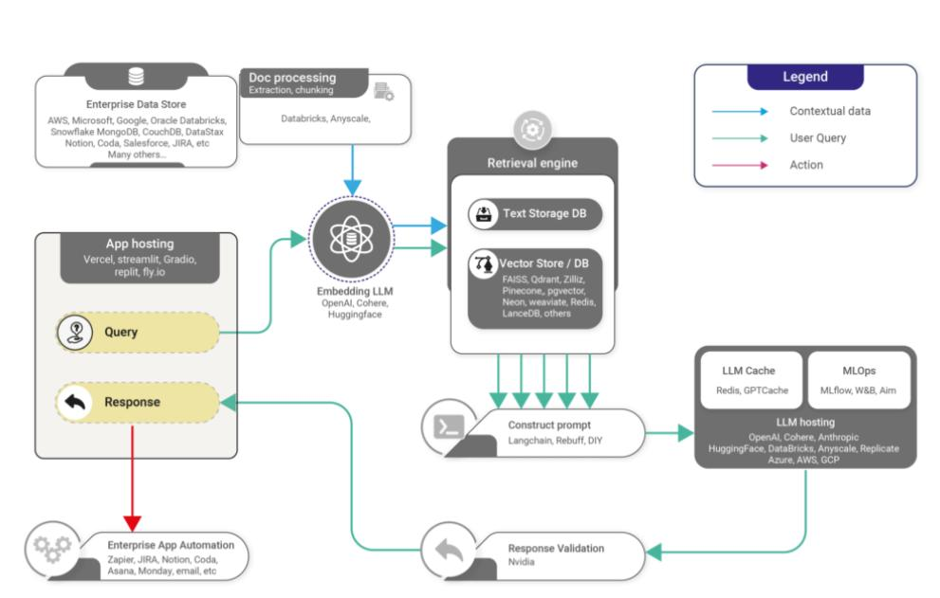

Slide 58
Prompt engineering
Prompt engineering is the process of designing and structuring inputs (prompts) in a way that helps AI models produce better and more accurate responses.
In RAG systems, prompt engineering ensures that retrieved information is properly included and clearly communicated to the language model. A well-designed prompt guides the model on how to use the context, what format to follow, and what type of response is expected.
Effective prompt engineering improves the quality, relevance, and consistency of AI-generated outputs.

Slide 59
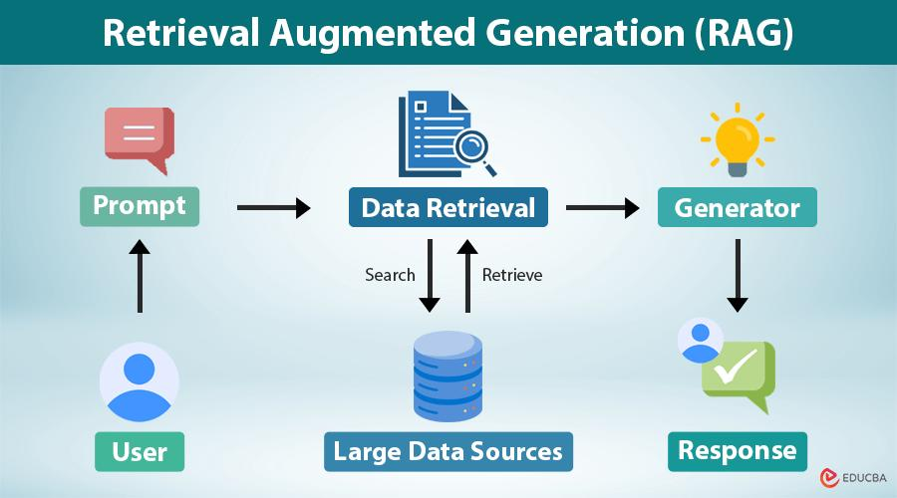

Slide 60
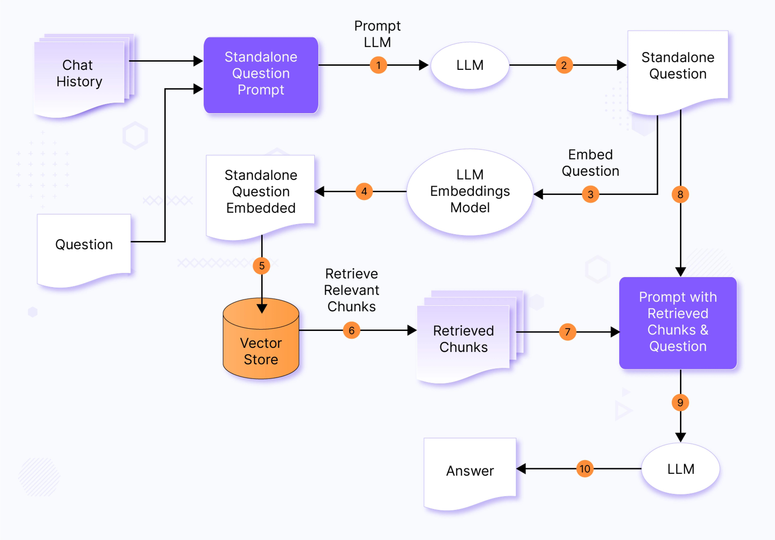

Slide 61
Context augmentation
Context augmentation is the process of adding relevant retrieved information to the user’s input before sending it to a language model. This extra information comes from external sources like documents, databases, or search systems.
By enriching the input with useful context, the model can generate more accurate and informed responses instead of relying only on its internal training data.
Context augmentation is a key step in RAG systems because it bridges the gap between retrieved knowledge and generated answers.

Slide 62
LLM Fundamentals
Topics~ 1. Tokens 2. Hallucination Mitigation 3. Prompting

Slide 63
Tokens
Tokens are the basic units of text used by Large Language Models. Instead of reading full sentences as humans do, LLMs break text into smaller pieces called tokens, which can be words, parts of words, or punctuation.
For example, the sentence “AI is powerful” might be split into tokens like “AI”, “is”, and “powerful”.
Tokens are important because LLMs process and generate text one token at a time, and limits on input/output are also measured in tokens.

Slide 64
Hallucination mitigation
Hallucination in LLMs refers to situations where the model generates incorrect or made-up information that sounds believable. Hallucination mitigation is the process of reducing these errors and improving factual accuracy.
This can be done using techniques like retrieval-augmented generation (RAG), better prompting, using verified data sources, and fine-tuning models on high-quality datasets.
The goal is to make AI responses more reliable, factual, and trustworthy.

Slide 65
Prompting
Prompting is the process of giving instructions or questions to a Large Language Model to guide its output. The way a prompt is written strongly affects the quality and relevance of the response.
Good prompting includes clear instructions, context, and desired output format. Different prompting techniques, such as few-shot or role-based prompting, can improve performance.
Effective prompting helps users control the behavior of LLMs and get more accurate and useful results.

